Slide 1
Man is to Computer Programmer as Woman is to Homemaker? Debiasing Word Embedding
NIPS’16
Tolga Bolukbasi, Kai-Wei Chang, James Zou, Venkatesh Saligrama, Adam Kalai

Slide 2
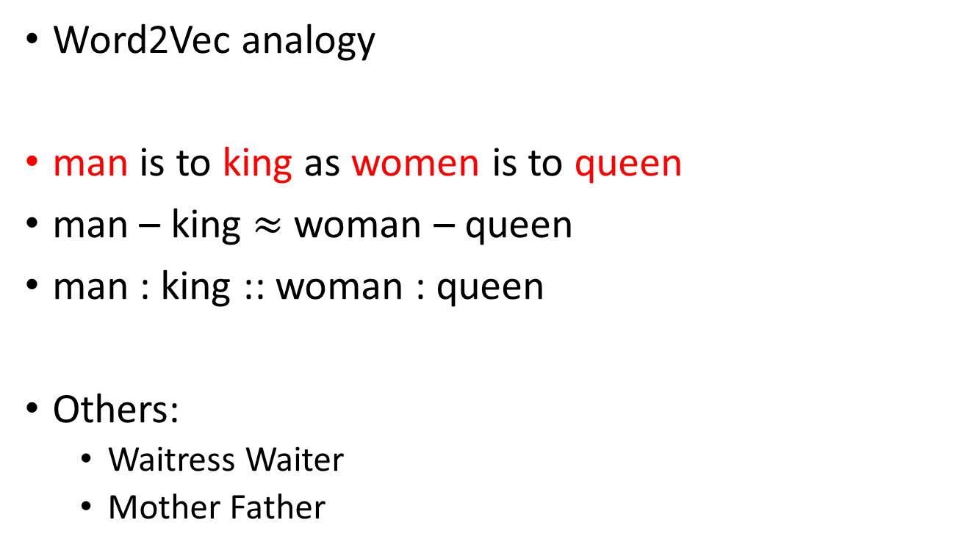
Word Embedding
Word2Vec analogy
man is to king as women is to queen
man – king $≈$ woman – queen
man : king :: woman : queen
Others:
Waitress Waiter
Mother Father

Slide 3
Bias and Stereotype
Others
volleyball - football
nurse - doctor
lovely - brilliant
…

Slide 4
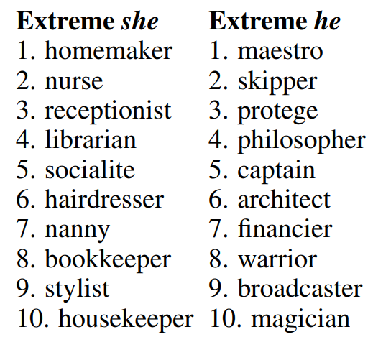
Occupational Stereotypes

Slide 5
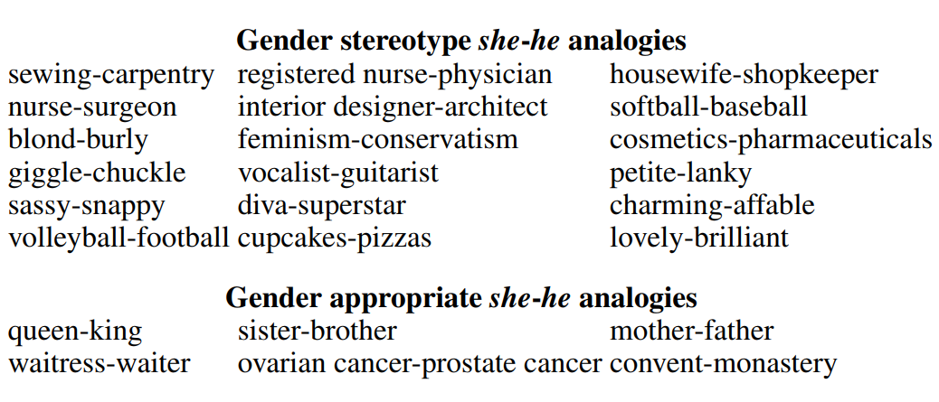
Analogies Exhibiting Stereotypes
Neutral words
Equality words

Slide 6
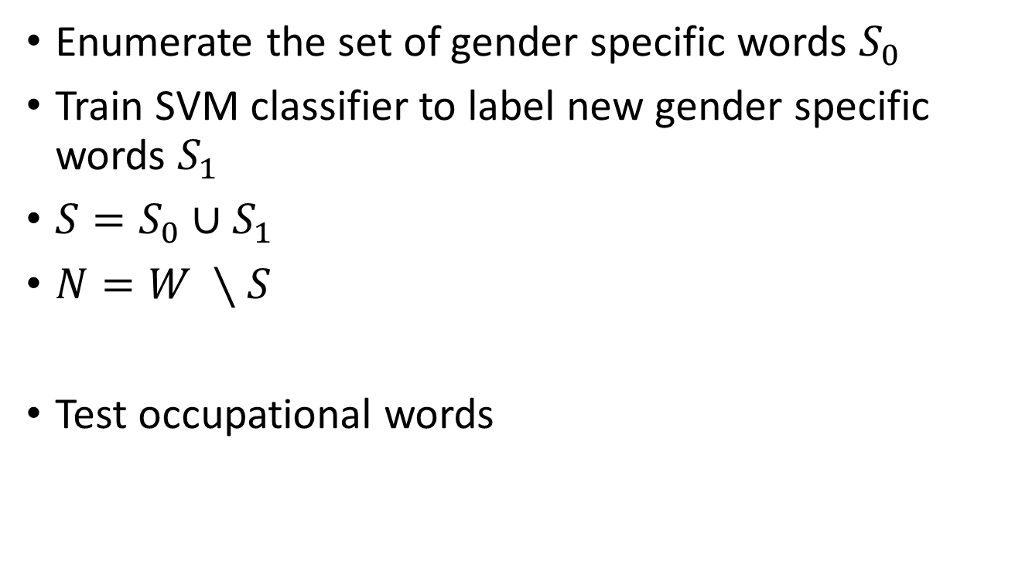
Gender neutral words
Enumerate the set of gender specific words $S_{0}$
Train SVM classifier to label new gender specific words $S_{1}$
$S=S_{0}∪S_{1}$
$N=W ∖S$
Test occupational words

Slide 7
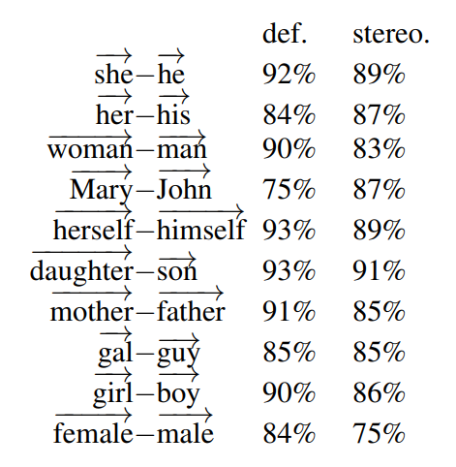
Gender Subspace
she
he
her
his
girl
boy

Slide 8

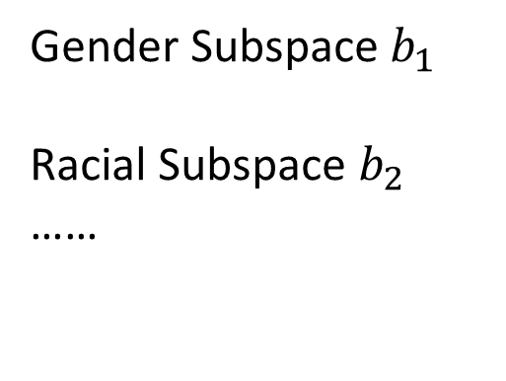
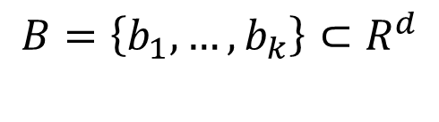
she
he
Gender Subspace $b_{1}$
Racial Subspace $b_{2}$
……
her
$$b_{1}$$
his
girl
$$B=\left\{b_{1},…,b_{k}\right\}⊂R^{d}$$
boy

Slide 9
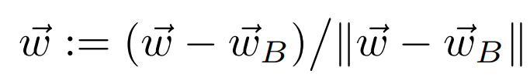

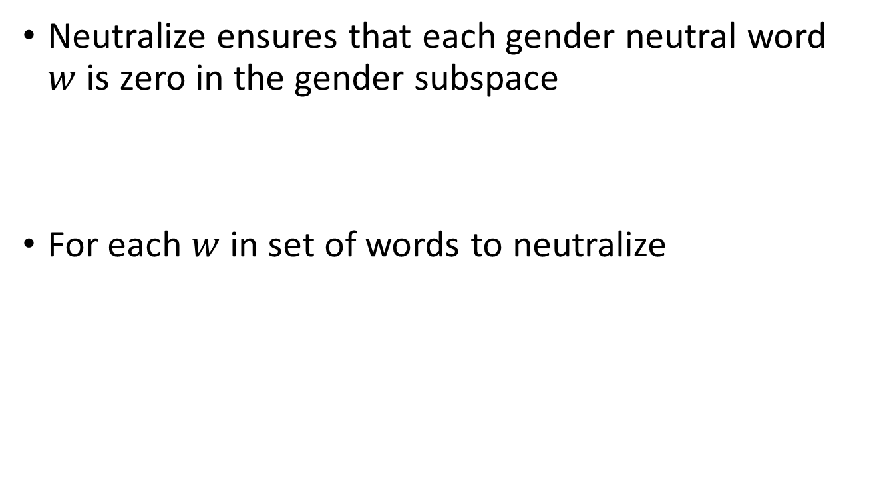



Hard debiasing-Neutralize
Neutralize ensures that each gender neutral word $w$ is zero in the gender subspace
For each $w$ in set of words to neutralize
$$w$$
New
$$w$$
$$w_{B}$$
$$B$$

Slide 10

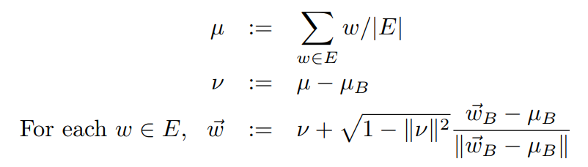
Hard debiasing-Equalize
Equalize perfectly equalizes sets of words outside the subspace and thereby enforces the property that any neutral word is equidistant to all words in each equality set

Slide 11



Hard debiasing-Equalize
$$w_{2}$$
$$w_{1}$$
$$B$$

Slide 12
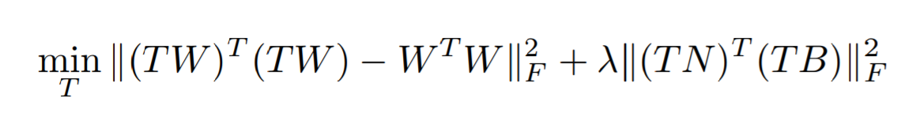

Soft debiasing
Gender neutral words $⊥$ Gender subspace

Slide 13
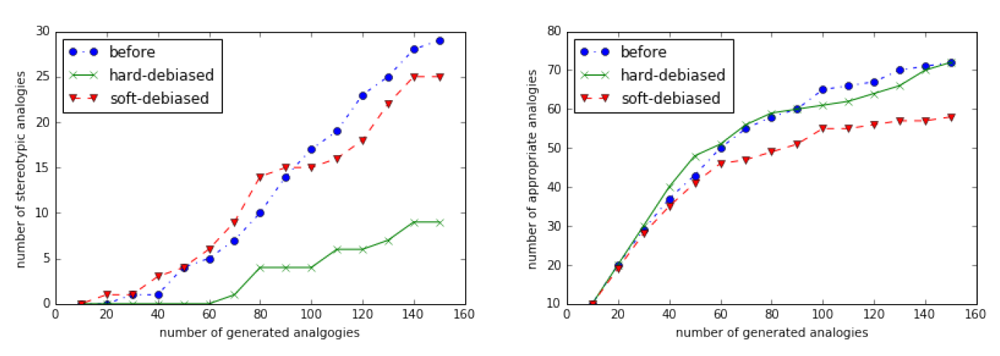
She-He analogies

